Slide 1
MEGA Warm-ups 3rd Grade

Slide 2
Question of the Day
Read the sentence below:
FINISHED FILES ARE THE RESULT OF YEARS OF SCIENTIFIC STUDY COMBINED WITH THE EXPERIENCE OF YEARS
How many f’s are there in that sentence?

Slide 3
Question of the Day
Perform the calculation below as fast as you can, and using only mental arithmetic (so without pen and paper, or a calculator!).
Take 1000 and add 40. Add 1000. Add 30 and then add 1000. Add 20. Add 1000 and then add 10.
The Question: What is the result of this calculation?
Notes:
5000

Slide 4
Third Grade
Below you find a number of words written in different colors. Try to name the colors you see as fast as possible. This means that you should list the names of the colors in which the words are written, and not read the words themselves.
black blue green orange pink yellow purple red black white

Slide 5
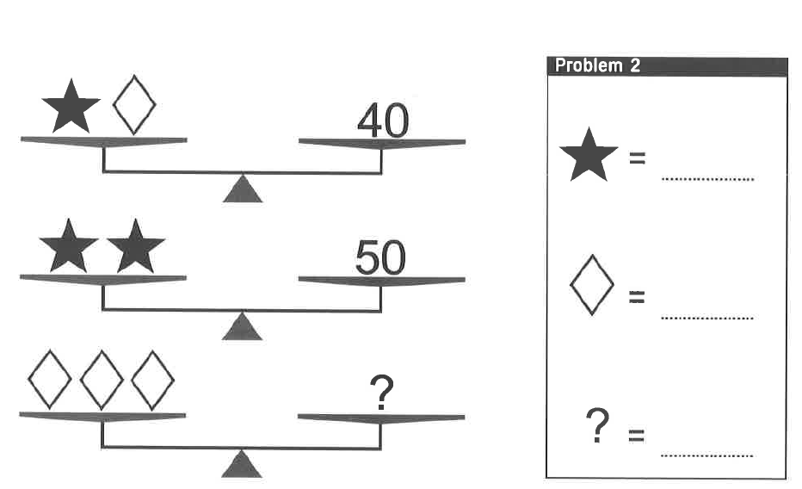
Third Grade
25
15
45

Slide 6
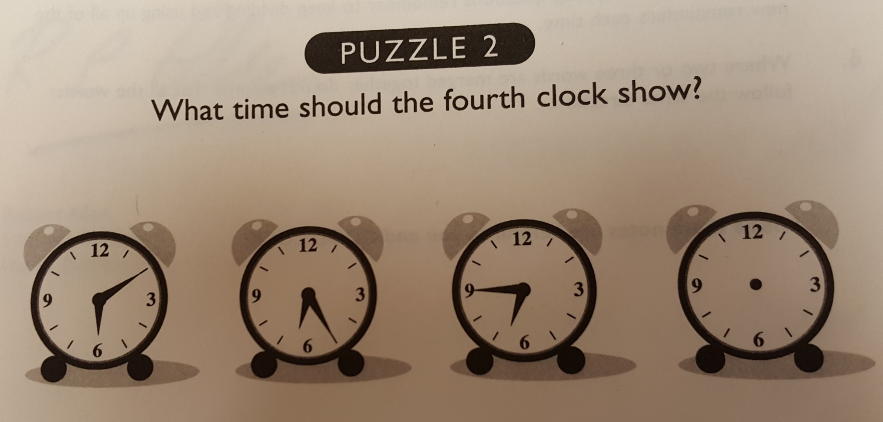
Third Grade
Notes:
30

Slide 7

Week Six
Do you see a series of black shapes on a white background, or do you see a white word on black background?
Notes:
This image is an exam­ple of an ambigu­ous illu­sion — a pic­ture or object that requires per­cep­tual switch­ing between the alter­na­tive inter­pre­ta­tions of fig­ure and ground. Our visual sys­tem sim­pli­fies visual scenes into a fore­ground fig­ure that we focus on and a ground which is every­thing else and forms the back­ground. And although you may be able to switch the fig­ure and ground back and forth to see one image or the other, your eyes will not let you see both images at the same time.

Slide 8
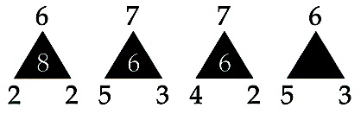
Third Grade
Question: Which figure should be placed in the empty triangle?
Notes:
ANSWER: 3 SOLUTION: The top number minus the bottom left-hand number is multiplied by the bottom right-hand number to give the number inside the triangle.

Slide 9
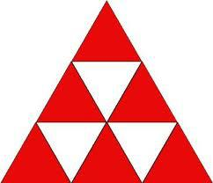
Third Grade
Question: How many triangles are there?
Notes:
13

Slide 10
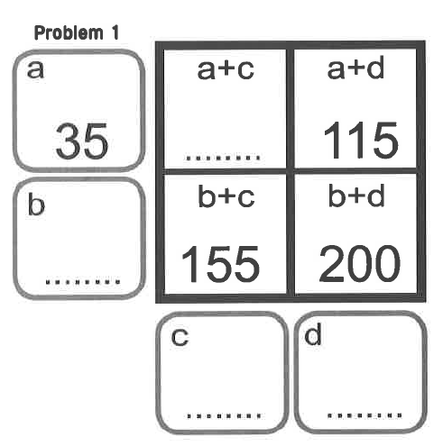
Third Grade
70
120
35
80
Notes:
ANSWER: 3 SOLUTION: The top number minus the bottom left-hand number is multiplied by the bottom right-hand number to give the number inside the triangle.

